Slide 1


ASK YOUR SENIOR
“YOUR PLACEMENT PARTNER”
Presented By:
1) Sakthilakshmi M (210701223)
2) Raveena Sri R (210701210)
3) Sam Lawremce V (210701225)
4) Ranjith Kumaran G (210701207)
5) Rachel Sherin J (210701200)
6) Priscilla Rachel (210701196)

Slide 2
PROBLEM STATEMENT:
Interview Preparation Challenges: Students often struggle with preparing for technical interviews due to the lack of structured guidance on what topics to study and the types of questions they might encounter during different interview rounds. This uncertainty can hinder their confidence and effectiveness in interviews.
Information Overload: Existing platforms like Glassdoor, Indeed, and Geeks for Geeks provide extensive resources and reviews on interview processes, but the overwhelming volume of information can be difficult to navigate. Students may spend excessive time filtering through this data, which can lead to information fatigue and missed critical details .
Communication Gap: There is often a significant communication gap between juniors and seniors in educational institutions. Juniors lack access to the experiential knowledge of seniors who have successfully navigated the interview process, which can be crucial for effective preparation .
Inconsistent Quality of Advice: The advice and information available online can vary greatly in quality and relevance. Students may encounter outdated or less reliable sources, leading to inconsistent preparation outcomes. The variability in information quality can add to the confusion and stress associated with interview preparation .
Time Constraints: Preparing for interviews is a time-sensitive task. The need to quickly and efficiently gather and assimilate relevant information is crucial. Current methods of preparation, which involve extensive searching and sifting through multiple resources, are time-consuming and inefficient, often leaving students feeling unprepared as interview dates approach .

Slide 3
ABSTRACT:
Student Challenges in Interview Preparation: Students face difficulties in preparing for technical interviews, including uncertainty about what to study and how to prepare for different interview rounds.
Role of the Chatbot: "Ask Your Senior" is designed to bridge the gap between juniors and seniors by allowing students to ask a chatbot for advice and information on placements, gathered from seniors who have successfully navigated the interview process.
Information Provided by Chatbot: The chatbot offers details about companies, the number of interview rounds, types of questions asked, and preparation strategies, making it easier for students to prepare effectively.
Technological Implementation: The system uses React.js for the frontend, Flask for the backend, and integrates Google Gemini API and LangChain for natural language processing and chatbot functionalities.
Objective and Benefits: The primary goal is to streamline the placement preparation process, reduce the overwhelming amount of information students need to sift through, and provide a reliable source of guidance, thereby enhancing students' chances of success in their placements.

Slide 4
EXISTING SYSTEM:
GlassDoor
Indeed
Geeks For Geeks
Preplaced

Slide 5
PROPOSED SYSTEM:
Chatbot for Placement Guidance: Develop a chatbot that facilitates communication between juniors and seniors, providing tailored advice and information about interview preparation based on the experiences of seniors who have successfully completed their placements.
Frontend and Backend Technologies: Utilize React.js for building a user-friendly and responsive frontend, leveraging its component-based architecture to create a modular and maintainable user interface. Implement Flask as the backend framework to handle the application's logic and server-side operations efficiently.
Natural Language Processing (NLP) Integration: Integrate Google Gemini API to enable advanced natural language processing capabilities in the chatbot. This will allow the chatbot to understand and respond to complex queries, facilitating multi-turn conversations and providing accurate, context-aware answers.
Information Retrieval and Management: Use LangChain to simplify the integration of large language models (LLMs), enabling efficient management of prompts and retrieval of relevant information. This will help in constructing coherent responses and maintaining a high level of accuracy in the information provided by the chatbot.
Database and Storage: Employ FAISS (Facebook AI Similarity Search) database for efficient storage and retrieval of textual embeddings, ensuring that the chatbot can quickly access and deliver relevant information based on the queries posed by the students. This will enhance the performance and reliability of the system in delivering timely and accurate placement preparation guidance.

Slide 6
TECH STACK:
React Js
Flask
Google Gemini API
Faiss Database
LangChain

Slide 7
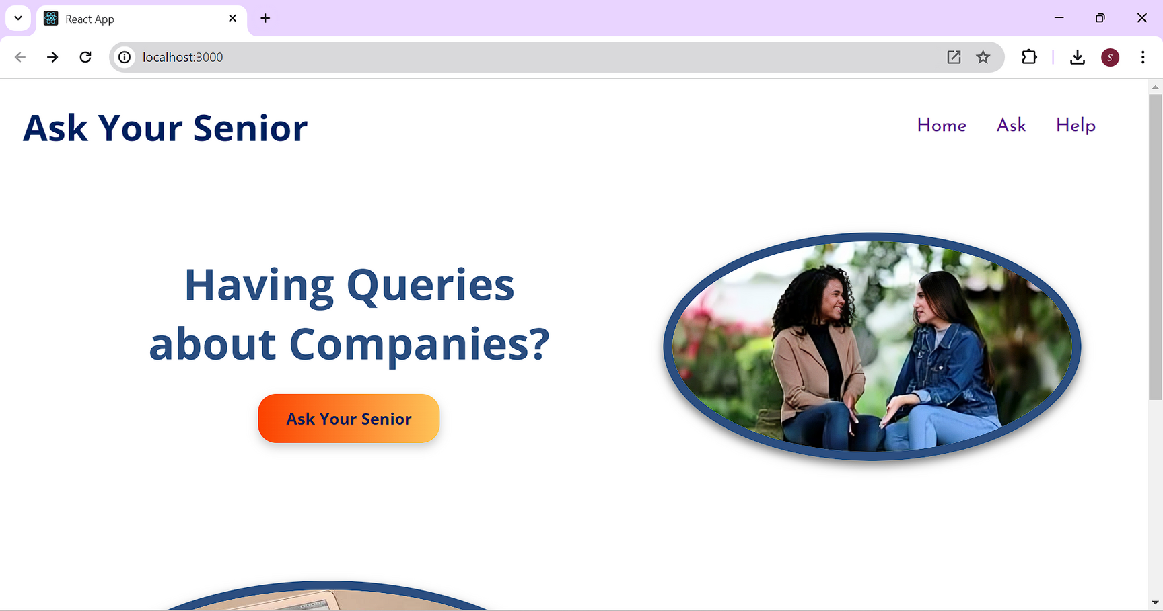
OUTPUT:

Slide 8
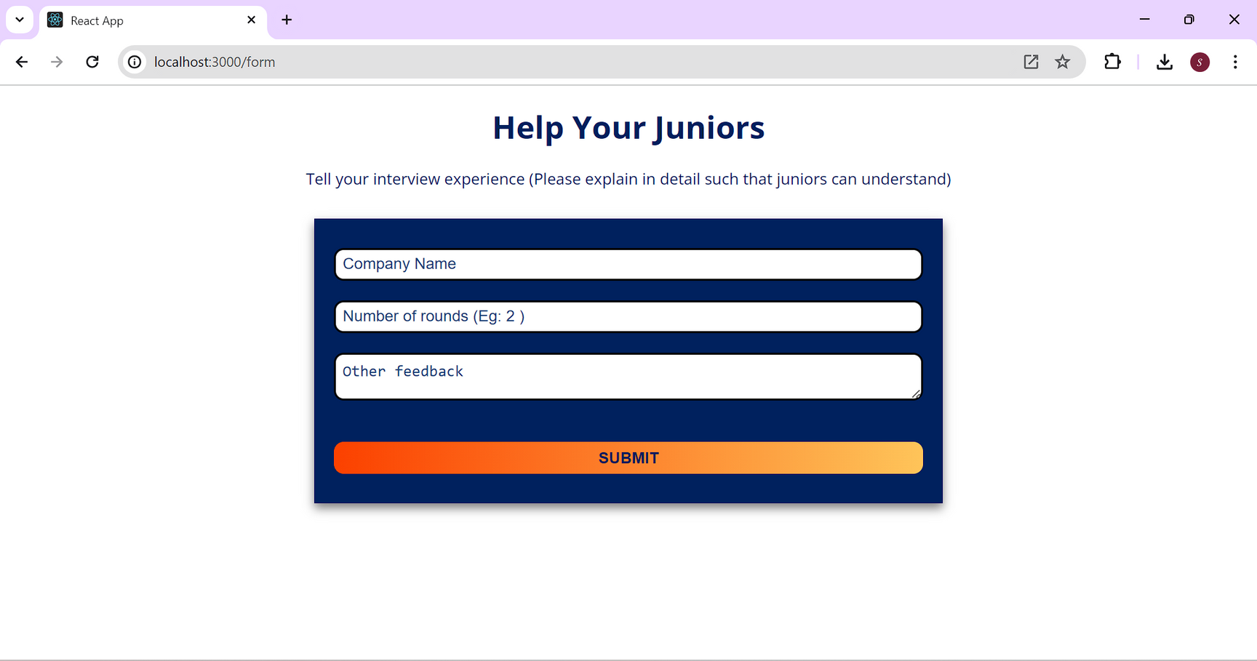

Slide 9
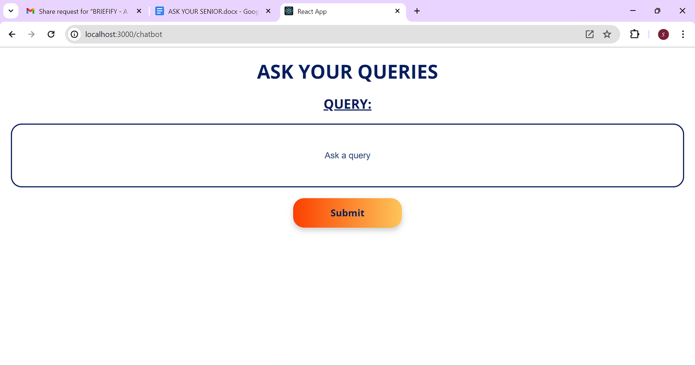

Slide 10
CONCLUSION:
Enhanced Interview Preparation: The proposed chatbot system effectively addresses the challenges faced by students in preparing for technical interviews by providing structured and reliable guidance.
Bridging Communication Gaps: By facilitating communication between juniors and seniors, the system ensures valuable experiential knowledge is easily accessible.
Efficient Information Management: Integration of advanced NLP and information retrieval technologies ensures students receive accurate and context-aware responses quickly.
Time-Saving Solution: The chatbot significantly reduces the time and effort required to gather and sift through extensive information, making preparation more efficient.
Increased Success Rates: Ultimately, the system aims to enhance students' confidence and success rates in placements by offering a streamlined and supportive preparation process.

Slide 11
FUTURE ENHANCEMENT:
Expanded Knowledge Base: Continuously update and expand the knowledge base with more companies, interview questions, and preparation tips from a broader range of seniors.
Personalized Learning Paths: Implement AI-driven personalized learning paths that adapt to individual student needs and progress, offering customized study plans and resources.
Multilingual Support: Introduce multilingual support to cater to a diverse student population, ensuring language is not a barrier to accessing valuable interview preparation guidance.
Interactive Mock Interviews: Develop interactive mock interview features that simulate real interview scenarios, providing students with hands-on practice and instant feedback.
Integration with Other Educational Tools: Integrate the chatbot with other educational tools and platforms, such as learning management systems (LMS) and coding practice sites, for a seamless and comprehensive preparation experience.

